Slide 1
NGB J81 Planning and Analysis Division (J-81)
JTLS-GO
Installation – NGB has not been approved to install JTLS-GO on the NGB network. NGB J81 has worked with Valkyrie software engineers to install the platform on a stand-alone laptop.
Utilization – NGB J81 will initially utilize JTLS-GO as a supplement to our wargaming effort with plans to expand this to a more extensive modeling and simulation.
Project – We are currently integrating JTLS-GO with a New Madrid Seismic Zone Wargame (NMSZ) Response Scenario for the Arkansas National Guard.

Slide 2
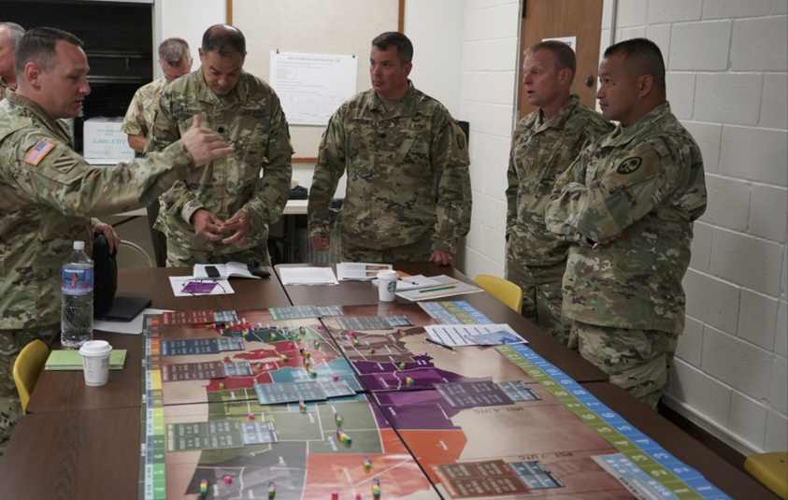
NGB J81 Wargaming
NGB-J81 Wargaming Program began designing, developing, and facilitating wargames in 2016.
In 2020 the Wargaming Program was codified as an official National Guard Bureau (NGB) program.
Since its inception, the NGB Wargaming Program has developed and facilitated over 18 NGB and State National Guard wargames.
NGB’s PRESIDIO TRINITY Wargame, 2018

Slide 3
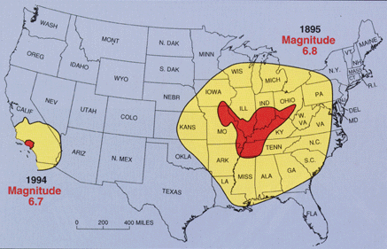
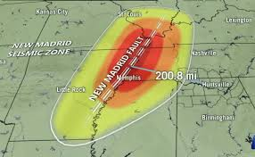
Arkansas National Guard
New Madrid Seismic Zone Wargame
The New Madrid Seismic Zone (NMSZ) is a region of high earthquake activity that encompasses eight states in the central United States, including Illinois, Indiana, Kentucky, Mississippi, Missouri, Arkansas, Tennessee, and Oklahoma. The zone is named after the town of New Madrid, Missouri, which was the epicenter of a series of powerful earthquakes that occurred in the early 19th century.
The NMSZ is still active today, and there is a significant risk of another major earthquake occurring in the region. The United States Geological Survey (USGS) estimates that there is a 25-40% chance of a major earthquake (magnitude 7.0 or greater) occurring in the NMSZ within the next 50 years.
A major earthquake in the NMSZ could have significant consequences, including:
Catastrophic damage to buildings and infrastructure within the eight affected states, centered around the epicenter and fault line
Major loss of life and injury to people in the affected area
Severe impact to the United States economy for months to years
Wide-spread disruption of critical services, such as power, water, and transportation extending well beyond the eight affected states

Slide 4
NGB J81 Planning and Analysis Division (J-81)
Wargame Objective
NGB J81 and Arkansas National Guard are conducting a wargame to validate feasibility and executability of response forces and equipment into the area for recovery and support operations

Slide 5
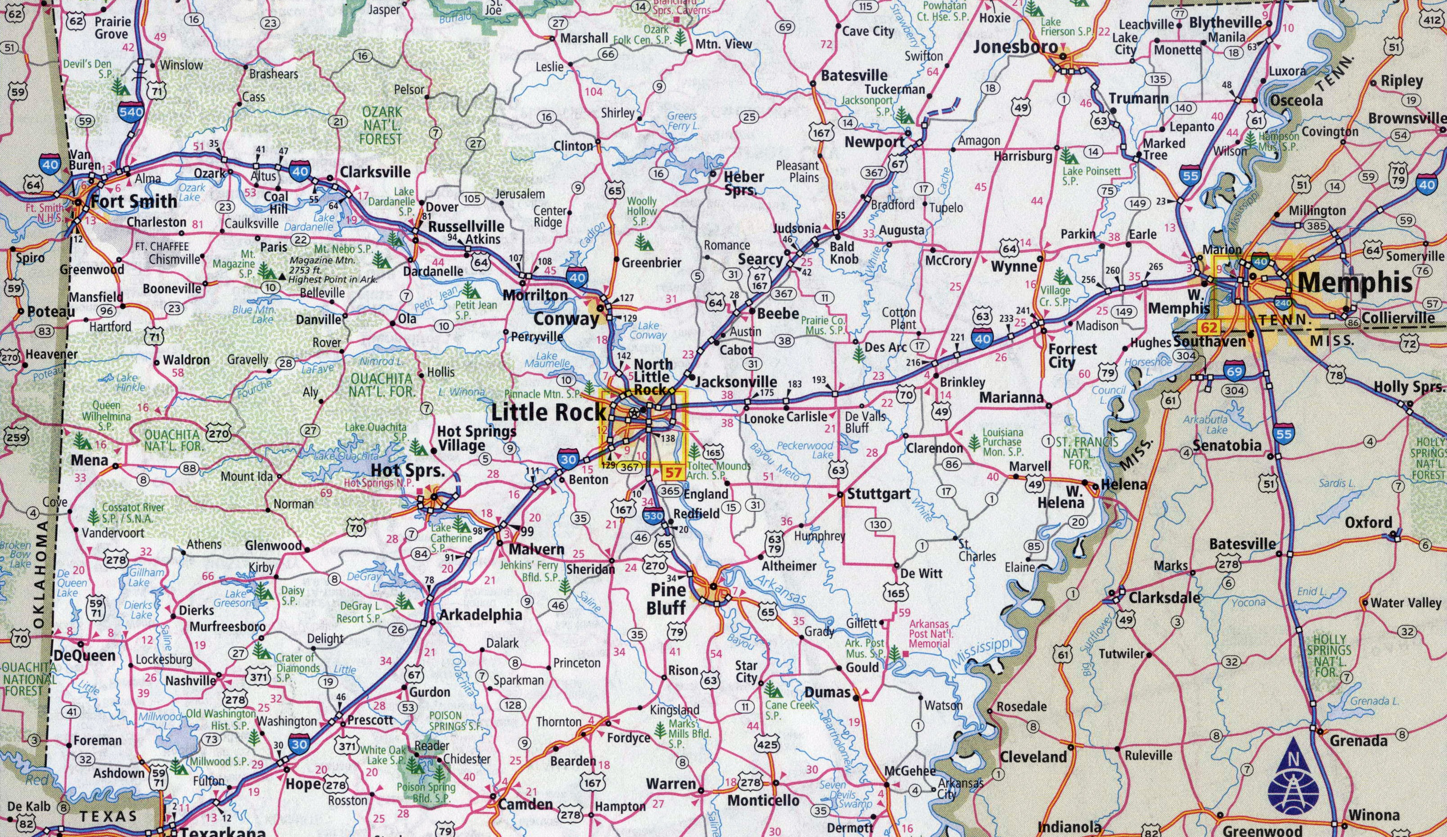
NMSZ Modeling
Notes:
the wargame.

Slide 6
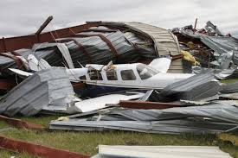
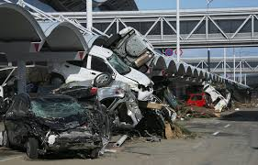
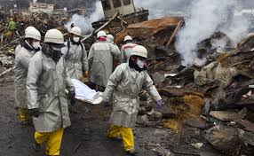
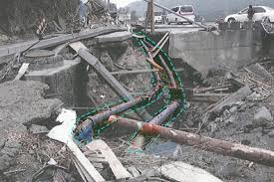
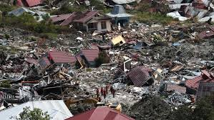
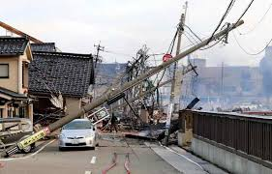
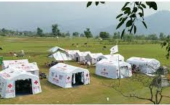
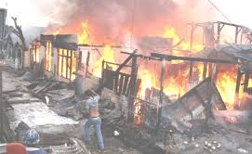
NGB J81 Planning and Analysis Division (J-81)
Modeling & Simulation Future Refinement

Slide 7
J81 NGB JTLS-GO Modeling & Simulation Optimal Manning w/Multiple Computers
Federated
Key Staff Positions
Exercise Director | COL/LTC | Plans and administer the Wargame exercise.
Senior Controller/Exercise Controller | GS | Monitors the progress of the planning and applies JTLS-GO to shape the scenario to meet operational requirements as specified by the Exercise Director.
Analyst NGB | CTR | Develops Data Collection Management Plan (DCMP) and monitors JTLS-GO execution to gain initial insights and key observations.
Computer Systems Manager | CTR | Configures the computers and coordinates systems software changes and hardware maintenance.
Technical Coordinator | CTR | Starts and stops the simulation and provide technical support for JTLS-GO.
Six Players assigned by function Human in the Loop Simulation
Commander | LTC/COL | Can perform all player functions.
Air Player | MAJ/CPT | Issue air mission directives only.
Intelligence Player | MAJ/CPT | Issue orders only to intelligence assets, processes information and passes information to interested players.
Logistics Player | MAJ/CPT | Is limited to establishing stockage objectives, directing resupply operations, and controlling convoys and supply networks.
Ground Player | MAJ/CPT | Manages the movement of scenario ground forces only.
Opposing Force Commander | LTC/COL | Can perform all opposing player functions.
Six Trained JTLS- GO Operators
6x JTLS-GO Operators | CTR | Enter execution orders based off assigned function
Cons
Requires six additional JTLS GO Computers
Requires six trained JTLS-GO Operators
Increase in Life Cycle Replacement Budget
Pros
Realistic approach. Functions are inputted real-time vs delayed
Additional JTLS-GO computer can serve as a backup repository
Additional JTLS-GO computers can facilitate operator training at NGB
Key staff positions can simultaneously contribute to scenario build

Slide 8
J81 NGB JTLS-GO Modeling & Simulation Optimal Manning w/Multiple Computers
Federated
White Board or Projector
JTLS-GO Projected on Screen
Exercise Director | 1
Senior Controller/Exercise Controller | 1
Analyst NGB | 1
Computer Systems Manager | 1
Technical Coordinator | 1
JTLS-GO
Monitor
Air Player
&
JTLS GO Operator
Ground Player
&
JTLS GO Operator
Commander | 1
Air Player | 1
Logistics Player | 1
Intelligence Player | 1
Ground Player | 1
Opposing Force Commander | 1
Moveable Wall/Partition
Ex
Dir
CDR
&
JTLS GO Operator
Intel
&
JTLS GO Operator
Logistics
&
JTLS GO Operator
Sr CT/
Ex CT
JTLS-GO Operators | 6
Total | 17
Technical Coordinator
Computer System Manager
Analyst NGB
Opposition CDR
&
JTLS GO Operator

Slide 9
J81 NGB JTLS-GO Modeling & Simulation Minimal Manning with 1x Computer
Standalone
Key Staff Positions
Exercise Director/ Senior Exercise Controller/Exercise Controller | LTC/CIV | Plans and administer the WG exercise. Monitors the progress of the planning and applies JTLS-GO to shape the scenario to meet operational requirements.
Analyst NGB | CTR | Monitors JTLS-GO execution to gain initial insights and key observations.
Technical Coordinator, Computer Systems Manger & JTLS-GO Operator | CTR | Starts and stops the simulation and provide technical support for JTLS-GO. Configures the computer and coordinates systems software changes and hardware maintenance. Enter orders based off all seven assigned JTLSO-GO functions.
Six Players assigned by function
Commander | LTC/COL | Can perform all player functions.
Air Player | MAJ/CPT | Issue air mission directives only.
Intelligence Player | MAJ/CPT | Issue orders only to intelligence assets, processes information and passes information to interested players.
Logistics Player | MAJ/CPT | Is limited to establishing stockage objectives, directing resupply operations, and controlling convoys and supply networks.
Ground Player | MAJ/CPT | Manages the movement of scenario ground forces only.
Opposing Force Commander | LTC/COL | Can perform all opposing player functions.
Cons
Function commands are funneled through one computer
No redundancy or back up computer to save scenario execution
One computer and operator used to build a scenario
Pros
Less impact on Life Cycle Replacement
Less manning/contract requirements
Key staff can fill in as functional roles.
Eliminating the requirement for Six Players.

Slide 10
J81 NGB JTLS-GO Modeling & Simulation Minimal Manning With One Computer
Standalone
White Board or Projector
JTLS-GO Projected on Screen
Exercise Director/ Senior Exercise Controller/Exercise Controller | 1
Analyst NGB | 1
Technical Coordinator, Computer Systems Manger & JTLS-GO Operator | 1
Technical Coordinator
Analyst NGB
Computer System Manager
COL/CPT Commander | 1
MAJ/CPT Air Player | 1
MA/CPT Intelligence Player | 1
MAJ/CPT Logistics Player | 1
MAJ/CPT Ground Player | 1
Opposing Force Commander | 1
Total | 3 or 9
Ex Dir/Sr CT/
Ex CT
CDR
Ground
Intel
Air
Logistics
Opposition CDR
&
JTLS GO Operator
Note- Key Staff can execute roles of Key Players

